Slide 1

Welcome

Slide 2
Atan Chakma
Lecturer: English
Banophool Adibashi Green Heart College
Class:xi
sub:English 1st
Unit one, lesson: one

Slide 3
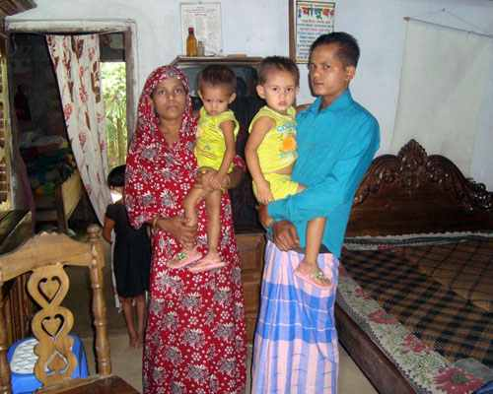
A nuclear family

Slide 4

A large family

Slide 5
Our families

Slide 6
Learning outcomes
After going through the lesson the students will be
capable of using vocabulary
able to differentiate between a nuclear family and large family
capable of forming sentence structure
able to communicate fluently on family affairs

Slide 7
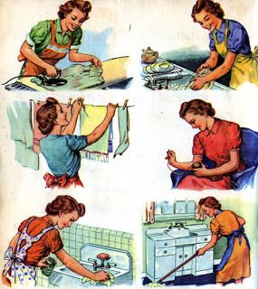
Vocab
Chores
Activities

Slide 8

Scream
Shout

Slide 9
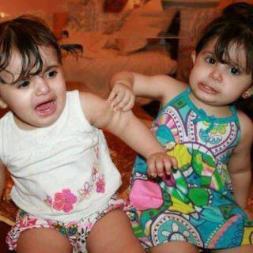
Envy
Jealousy

Slide 10

A Happy nuclear family

Slide 11


Loneliness

Slide 12

Happy extended family

Slide 13
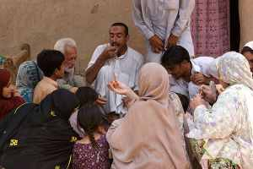
Love and share
But scarcity of food
Notes:
ভিডিও লিংকঃhttp://www.youtube.com/watch?v=lRD0KciYxoM

Slide 14
Sentence structure:
I wish + Sub + would/could + Verb (PP).
I wish I could live in an extended family.

Slide 15
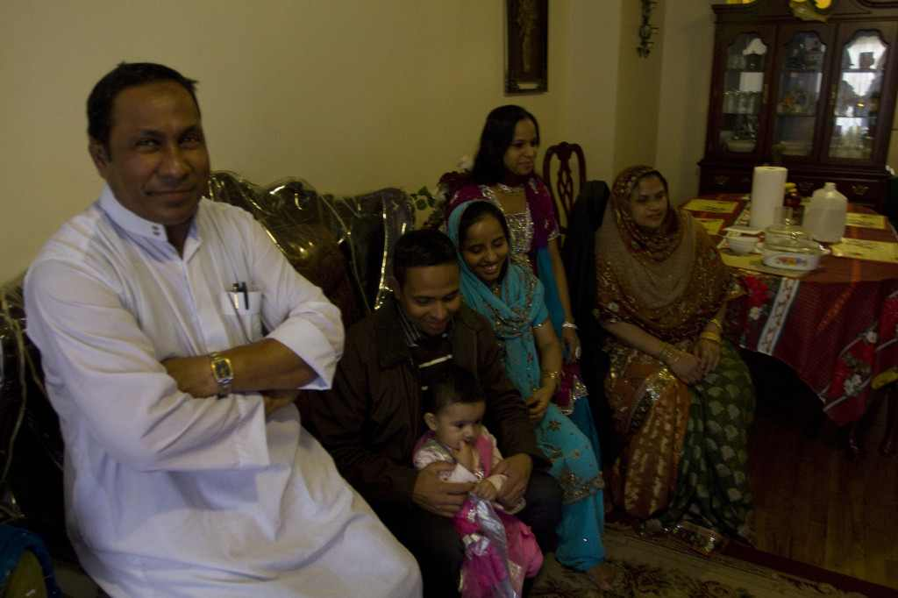
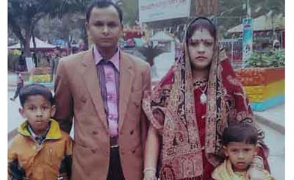
Group work:
Write some merits and demerits of a nuclear family and a large family

Slide 16
Evaluation:
Would you able to say few lines of your family?
Would you able to differentiate your family from the given family?
What kinds of problems does a member of nuclear family usually face?

Slide 17
Assignment:
Write down a comparative paragraph on a nuclear family and an extended family.

Slide 18
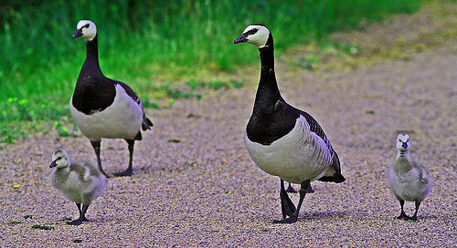
Thanking you all

